Slide 1
JAVA DAY 2

Slide 2
VARIABLES
Variables are used as containers to hold values (int, long, string…) during the life cycle of an application.
Variable is the name of memory location.
It is a combination of "vary + able" that means its value can be changed.
A variable is assigned with a datatype.
To declare a variable follow the syntax
data_type variable_name = value ;
Example:
int age = 25 ;

Slide 3
TYPES OF VARIABLES
In Java it provides 3 variable types
Local Variable
Instance Variable
Class / Static Variable

Slide 4
DATA TYPES
Data types in java specify the size and type of values that can be stored in an identifier.
There are two types of data types in Java
Primitive Data Types
Non – Primitive Data Types

Slide 5
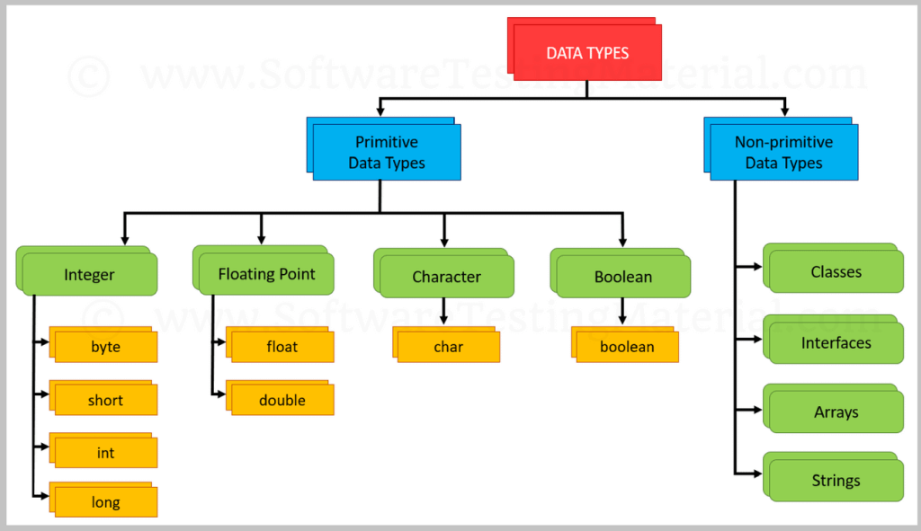

Slide 6
PRIMITIVE DATA TYPES
Java Provides 8 primitive data types. Size of these 8 primitive data types wont change from one OS to other.
byte, short, int & long – stores whole numbers
float, double – stores fractional numbers
char – stores characters
boolean – stores true or false

Slide 7
Data Type | Default Value | Default size
boolean | false | 1 bit
char | '\u0000' | 2 byte
byte | 0 | 1 byte
short | 0 | 2 byte
int | 0 | 4 byte
long | 0L | 8 byte
float | 0.0f | 4 byte
double | 0.0d | 8 byte

Slide 8
Non – Primitive Data Types
A reference data type is used to refer to an object.
A reference variable is declare to be of specific and that type can never be change.
Example
String program = “JAVA”;

Slide 9
CONTROL STATEMENTS
The statements that control the execution flow of the program are known as control statements.
There are 3 types
Conditional Statements
Looping / Iteration Statements
Jump Statements

Slide 10
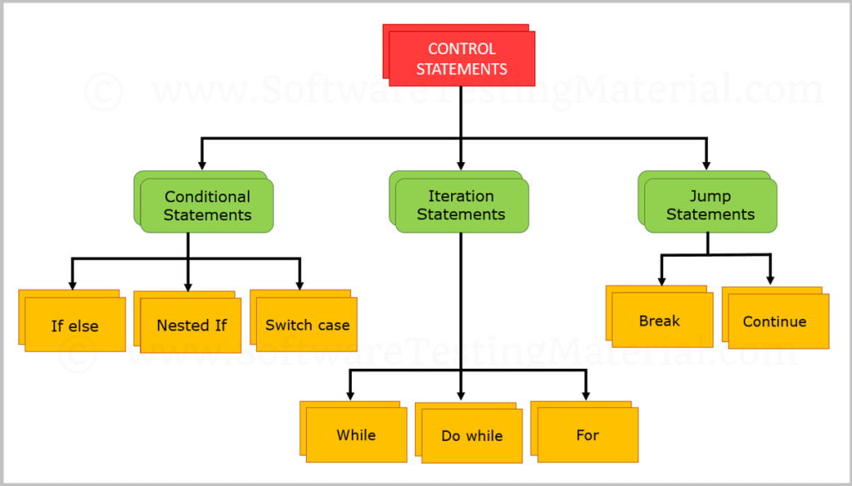

Slide 11
CONDITIONAL STATEMENTS
Let’s see the following conditional statements
1. if statement 2. nested if statement 3. if-else statement 4. if-else-if statement 5. Switch Case Statement

Slide 12
IF STATEMENT
The Java if statement tests the condition. It executes the if block if condition is true.
Syntax:
if(condition)
{
//code to be executed
}

Slide 13
IF - ELSE STATEMENT
The Java if-else statement also tests the condition. It executes the if block if condition is true otherwise else block is executed.
Syntax:
if(condition)
{
//code if condition is true
}
else
{
//code if condition is false
}

Slide 14
IF – ELSE LADDER
The if-else-if ladder statement executes one condition from multiple statements.
Syntax:
if(condition1){
code to be executed if condition1 is true
}else if(condition2){
code to be executed if condition2 is true
} else if(condition3){
code to be executed if condition3 is true
} ...
else{
code to be executed if all the conditions are false
}

Slide 15
NESTED IF STATEMENT
The nested if statement represents the if block within another if block. Here, the inner if block condition executes only when outer if block condition is true.
Syntax:
if(condition)
{
code to be executed
if(condition)
{
code to be executed
}
}

Slide 16
SWITCH CASE
The Java switch statement executes one statement from multiple conditions.
It is like if-else-if ladder statement.
Syntax
switch(expression){
case value1:
//code to be executed;
break; //optional
case value2:
//code to be executed;
break; //optional
......
default:
code to be executed if all cases are not matched;
}

Slide 17
LOOPING STATEMENTS
loops are used to execute a set of instructions/functions repeatedly when some conditions become true.
There are 4 types of loops in java.
for loop
while loop
do-while loop
enhanced for loop

Slide 18
For Loop
We can initialize the variable, check condition and increment/decrement value.
Syntax :
for(initialization ;condition ; Incr / decr)
{
//statement or code to be executed
}

Slide 19
WHILE LOOP
The Java while loop is used to iterate a part of the program several times.
If the number of iteration is not fixed.
Syntax
while(condition)
{
code to be executed
}

Slide 20
DO..WHILE LOOP
The Java do-while loop is used to iterate a part of the program several times.
If the number of iteration is not fixed and you must have to execute the loop at least once.
Syntax
do
{
//code to be executed
}while(condition);

Slide 21
JUMP STATEMENTS
BREAK
When a break statement is encountered inside a loop.
The Java break is used to break loop or switch statement.
It breaks the current flow of the program at specified condition.
In case of inner loop, it breaks only inner loop.
CONTINUE
The continue statement is used in loop control structure when you need to jump to the next iteration of the loop immediately.
The Java continue statement is used to continue the loop.
It continues the current flow of the program and skips the remaining code at the specified condition.
In case of an inner loop, it continues the inner loop only.

Slide 22
CLASS & OBJECTS
A class is a blueprint or prototype from which objects are created.
A class contains variables (data types) and methods (functions) to describe the behavior of an object.
Syntax :
Class Class_Name
{
data members
methods
}

Slide 23
CLASS & OBJECTS
Object is a real world Entity or Instance of a Class.
It has 2 Characteristics
State
Behaviour
State: It represents value (data types/variables) of an object
Behaviour: It represents the functionality (methods) of an object
Example:
State: Maker, Model, Colour etc.,
Behaviour: Turn on, Turn off etc.,

Slide 24
OBJECT CREATION
Let’s see how to create an object:
Building mall = new Building();
Class: Building
Reference: mall
Keyword: new
Constructor: Building()
Object: new Building()

Slide 25
THANK YOU

